Slide 1
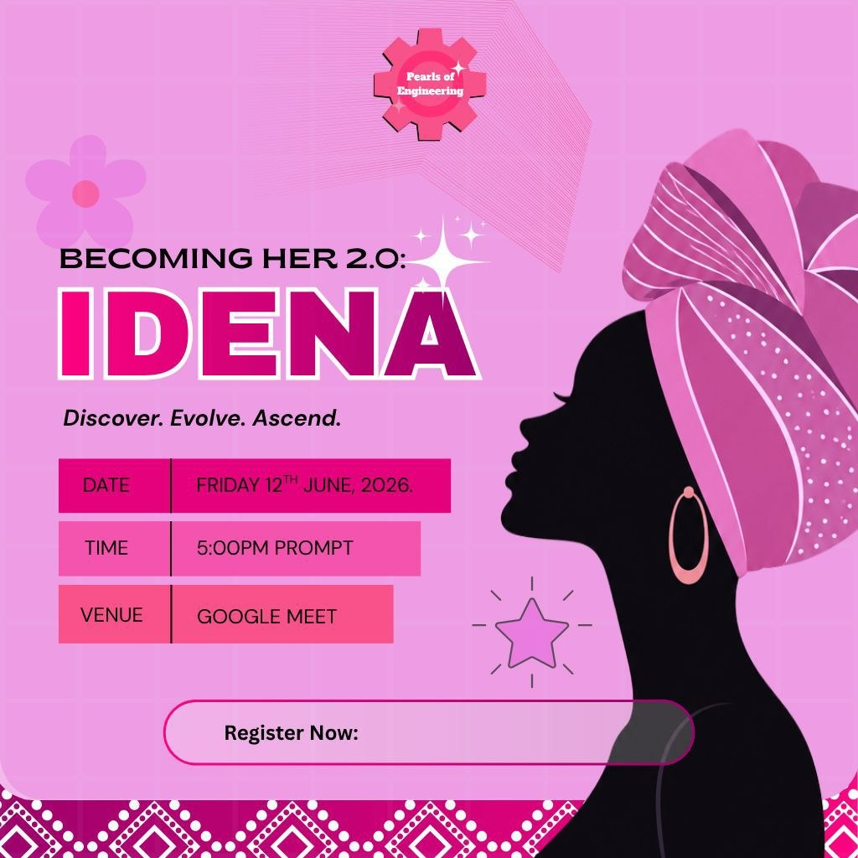
BECOMING HER 2.0
IDENA
Discover. Evolve. Ascend.

Slide 2
ABOUT IDENA
WHAT IS IDENA?
IDENA is the second edition of the Becoming Her Webinar — an annual virtual gathering hosted by young women in engineering. A conversation on identity, and the quiet but powerful shift that happens when a woman finally sees herself clearly.
WHY IDENA
Because identity is the first point of success. The way we see ourselves shapes every choice, every room, every becoming that follows. IDENA exists to help women refactor that picture — on their own terms.
WHO IS IT FOR
Every young woman. Whether you are figuring yourself out, or quietly rebuilding who you have always been — IDENA is for you. By young women, for young women.

Slide 3
WHAT YOU GAIN
01
02
03
04
REFRAME
REDISCOVER
CONNECT
CARRY FORWARD
HONEST CONVERSATIONS ON IDENTITY, SELF-WORTH, AND THE WOMAN BENEATH THE NOISE.
A COMMUNITY OF WOMEN NAVIGATING THE SAME SHIFT — QUIET, POWERFUL, ONGOING.
PRACTICAL TAKEAWAYS FROM SPEAKERS WHO HAVE WALKED THE PATH YOU'RE WALKING.
TOOLS TO REBUILD HOW YOU SEE YOURSELF — BEYOND THE VOICES THAT DEFINED YOU FIRST.
Notes:
For now, I can only create and edit one slide at a time. You can ask to edit this slide or create a new one.

Slide 4
BECOME A SPONSOR
🥇 GOLD — ₦200,000
stars
Top-tier logo placement, verbal recognition, 2-min spotlight, 5 social mentions, logo on registration, post-event feature, optional attendee list.
🥈 SILVER — ₦100,000
verified
Logo placement, verbal recognition at opening, 3 social mentions, post-event recap inclusion.
🥉 BRONZE — ₦50,000
workspace_premium
Logo on slides & landing page, 1 social mention, event acknowledgments.
Full sponsorship deck available on request.

Slide 5
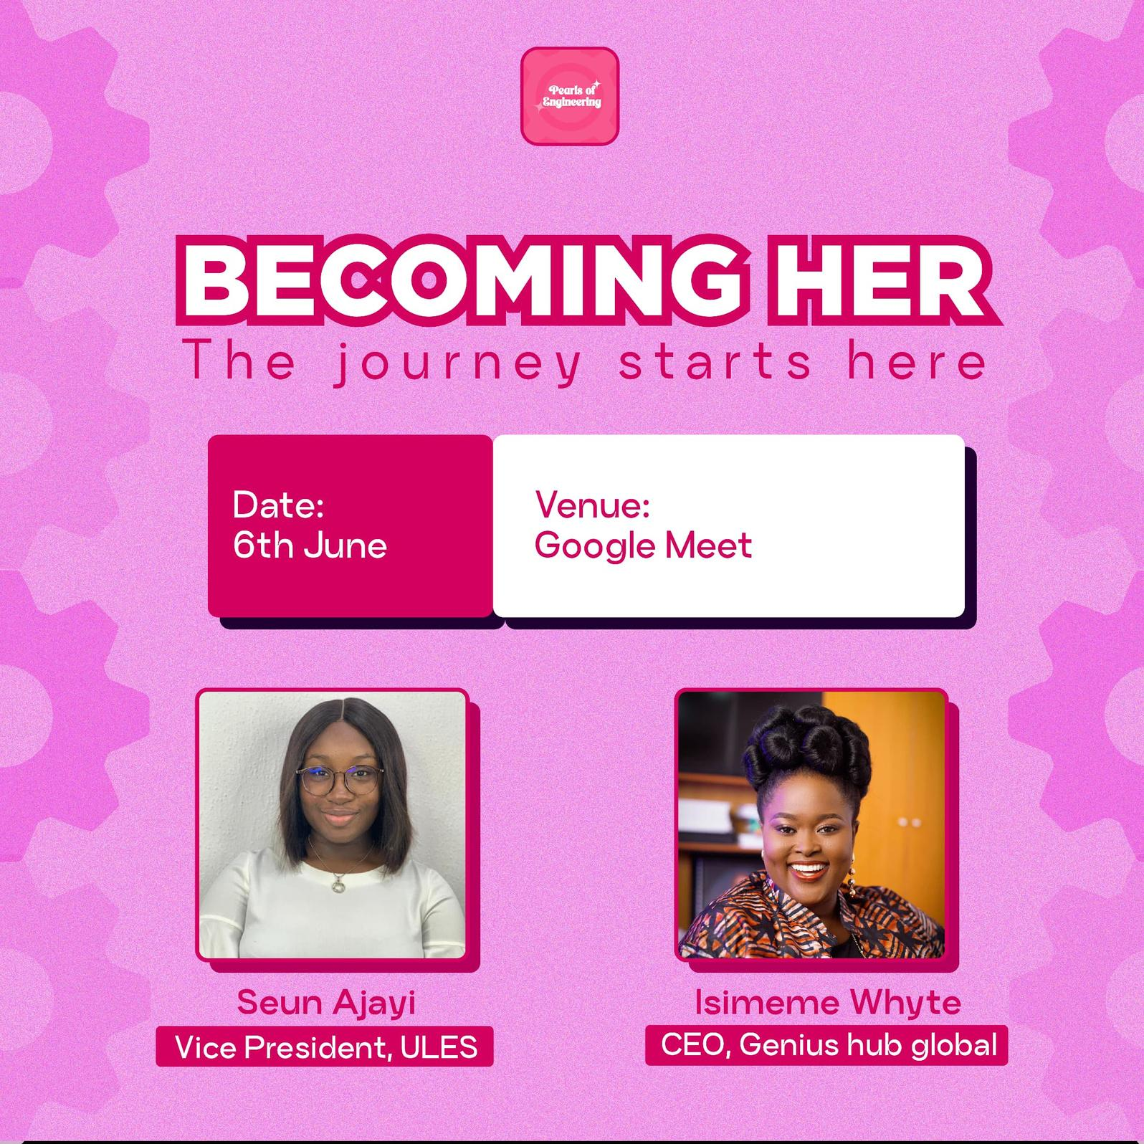
FROM BECOMING HER 1.0
Testimonial 1
“I learnt from Seun that I should not doubt my goals but rather let it keep pushing me”
-Tofarati
Testimonial 2
“I learnt that my circle of influence really matters in shaping who I become”
-Christabella
Testimonial 3
“I learnt from Mrs Isimeme that grit and consistency is very important to get things done”
-Adesewa

Slide 6
BE IN THE ROOM
Sponsorship inquiries: esabublessing7@gmail.com
General inquiries: engrpearls@gmail.com
Becoming Her 2.0: IDENA — Discover. Evolve. Ascend.

